Slide 1

Constructing spherical panoramas of a bladder phantom from endoscopic video using bundle adjustment
Timothy D. Soper, John E. Chandler, Michael P. Porter, Eric J. Seibel
SPIE Medical Imaging 2011,
Visualization, Image-Guided Procedures, and Modeling
Tuesday February 15th, 2011

Slide 2
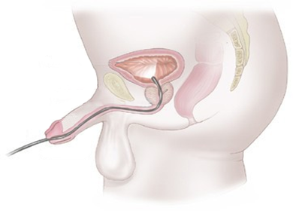
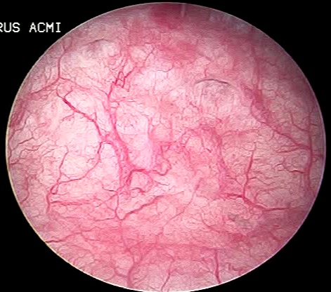
Bladder Surveillance
Bladder Cancer:
  5th most prevalent in U.S.¹
  70,530 new cases yearly
  Recurrence 50%
Flexible Cystoscopy
  Annual, semi-annual, or quarterly surveillance
  ~5mm diameter
  Local anesthesia
Rigid Cystoscopy
  Biopsy or resection
  General anesthesia
www.nhs.uk
¹ Jemal, A., Siegel, R., Xu, J. et al., “Cancer statistics, 2010,” CA Cancer J Clin, 60(5), 277-300 (2010).

Slide 3
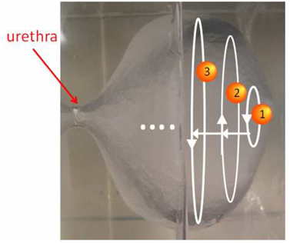
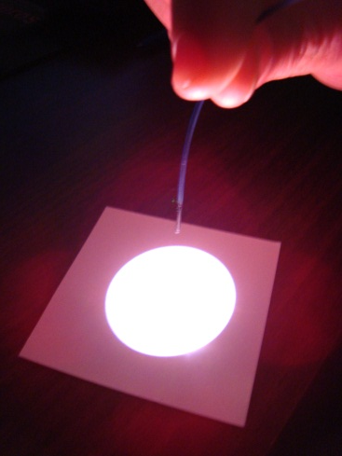
A New Approach to Bladder Surveillance
Scanning Fiber Endoscope
Ultrathin (1.5 mm)
Highly flexible
High Resolution (500 x 500)
Full-Color
30 Hz video frame rate
Advancement
Yoon, Sangtae, Reinhall, et al., 2009
Patient comfort
Laser diagnostics/therapies
Automation
Proposed Model
Replace urologist with nurse/technician
Implement automated scanning device
Urologist performs post-procedural review
Panorama

Slide 4
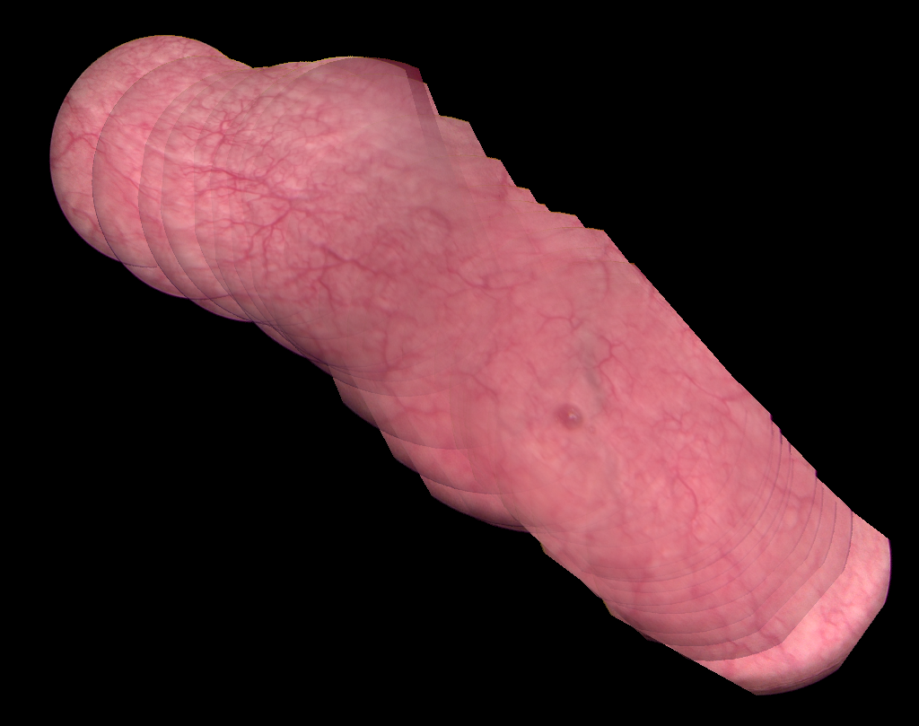
Image Alignment
Challenges:
Presumed planar geometry
Global alignment
Precalibration
Requirements for full panoramic
reconstruction :
Nonplanar
Free moving endoscope
360° field of view
Global alignment
Self calibrating
Not real time

Slide 5
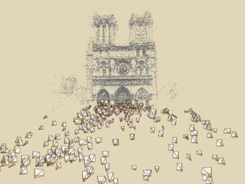
Structure from Motion
Simultaneous recovery of scene geometry and camera motion
[R, t ]
Virtual Tourism¹
¹Snavely, N., Seitz, S. M., and Szeliski, R., ACM Transactions on Graphics, 2006.

Slide 6
Software
Frame selection
Frame matching
Track assignment
Bundle adjustment
Stitching
VIDEO

Slide 7
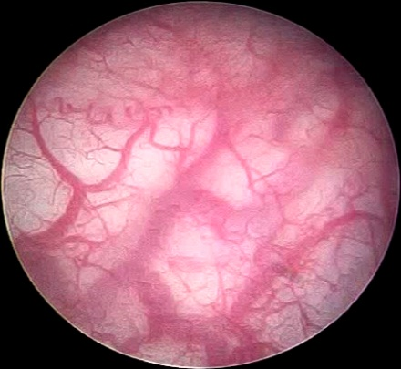
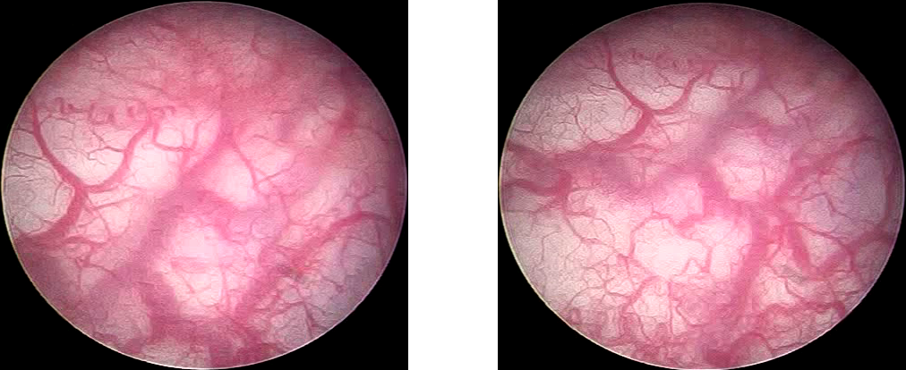
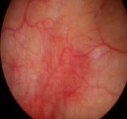
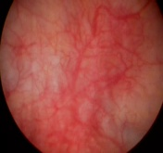
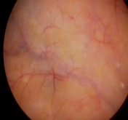
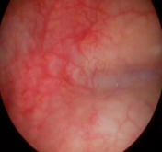
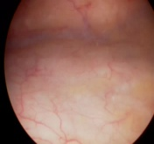
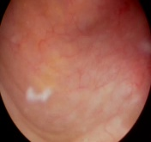
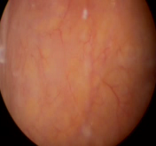
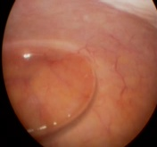
Frame Selection
Frame selection
Frame matching
Track assignment
Bundle adjustment
Stitching
VIDEO
Scale Invariant Feature Transform¹
Feature matching
Random sample concensus (RANSAC)
Sparse selection
1
N
¹Lowe, International Journal of Computer Vision, 2004

Slide 8




Frame Matching
Frame selection
Frame matching
Track assignment
Bundle adjustment
Stitching
VIDEO
$$j$$
Sequential matching
Nonsequential matching
$$k$$
Associated matching
$k$+3
$$k$$
$k$+3

Slide 9

Track Assignment
Frame selection
Frame matching
Track assignment
Bundle adjustment
Stitching
VIDEO
For all features consistently matched between 3+ frames:
assign as track
$$X=[X Y Z]$$

Slide 10















Bundle Adjustment
Frame selection
Frame matching
Track assignment
Bundle adjustment
Stitching
VIDEO
Non-linear least squares minimization between the observed and predicted pixel positions:
Camera Equations:
$$\tilde{x}, \tilde{y}$$
$${[X_{c} Y_{c} Z_{c}]}^{T}=R_{c}{[X Y Z]}^{T}+t_{c}$$
(3D rigid body)
$$\hat{x},\hat{y}$$
$(X_{c},Y_{c},Z_{c}$)
$$u_{0},v_{0}$$
$\hat{x}=\frac{X_{c}}{Z_{c}}, \hat{y}=\frac{Y_{c}}{Z_{c}}$
(projective)
$$O_{c}$$
$$\tilde{x}=x\left(1+κ_{1}r^{2}+κ_{2}r^{4}\right)$$
(radial distortion)
$$\tilde{y}=y\left(1+κ_{1}r^{2}+κ_{2}r^{4}\right)$$
$$f=u−\tilde{u}, c=f^{T}f$$
$$\tilde{u}=f_{x}\tilde{x}+u_{0}, \tilde{v}=f_{y}\tilde{y}+v_{0}$$
(camera
equations)
$$3M$$
$$6N$$
$$6$$
State variable: $x=[X_{1}^{T},…,X_{M}^{T}, θ_{1}^{T},t_{1}^{T},…,θ_{N}^{T}, t_{N}^{T}, f_{x}, f_{y}, u_{0}, v_{0}, κ_{1},κ_{2}]$
Update: $Δx={−\left(H+λ⋅diag\left(H\right)\right)}^{−1}∇c(x)$
Levenberg-Marquardt
Large parameter sets solved by exploiting sparsity!
3D point parameters and camera parameters do not combine
Each camera sees only a subset of points

Slide 11

Bundle Adjustment
Frame selection
Frame matching
Track assignment
Bundle adjustment
Stitching
VIDEO
Implementation:
Constrain mosaic to spherical surface
Constrain frames to lie within sphere.
Incremental adjustment
$$\left(X,Y,Z\right)→(θ, φ, 1)$$
add and initialize first frame
add visible tracks and project
bundle adjust
add frames and estimate pose
bundle adjust

Slide 12
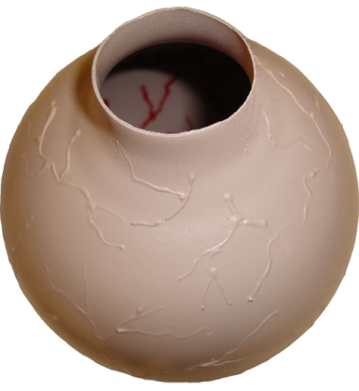
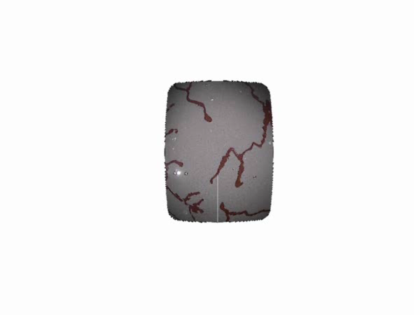
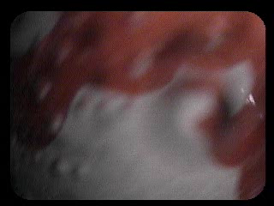
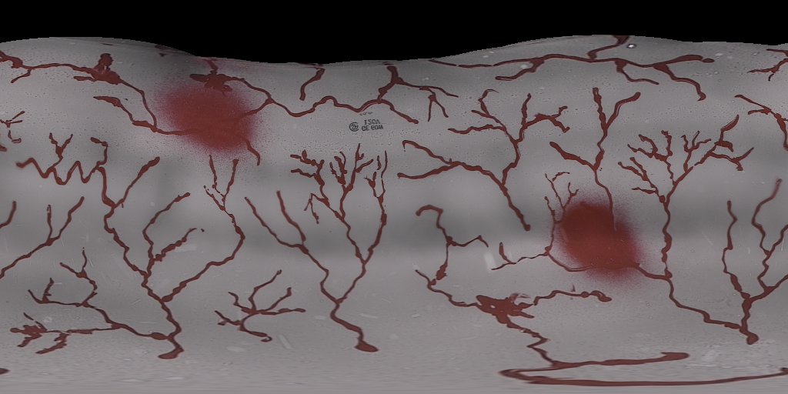
Experiment 1: Bladder Phantom
240 frames
Projection error = 0.47 pixels

Slide 13
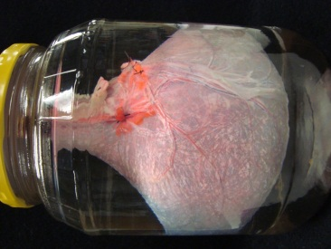
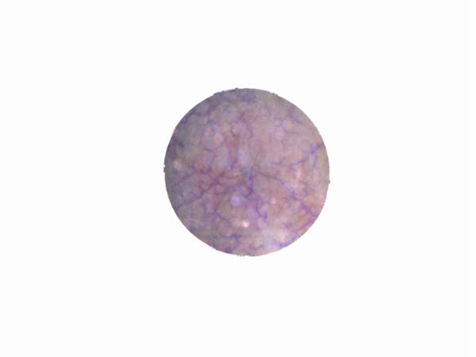
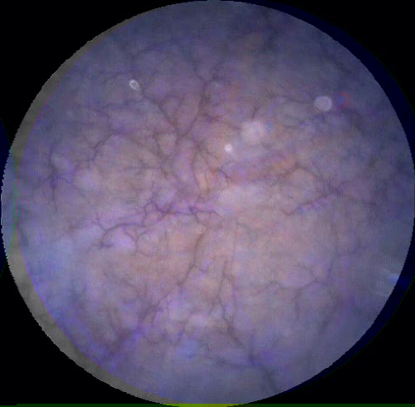
Experiment 2: Excised Pig Bladder
857 frames
Projection error = 1.41 pixels

Slide 14
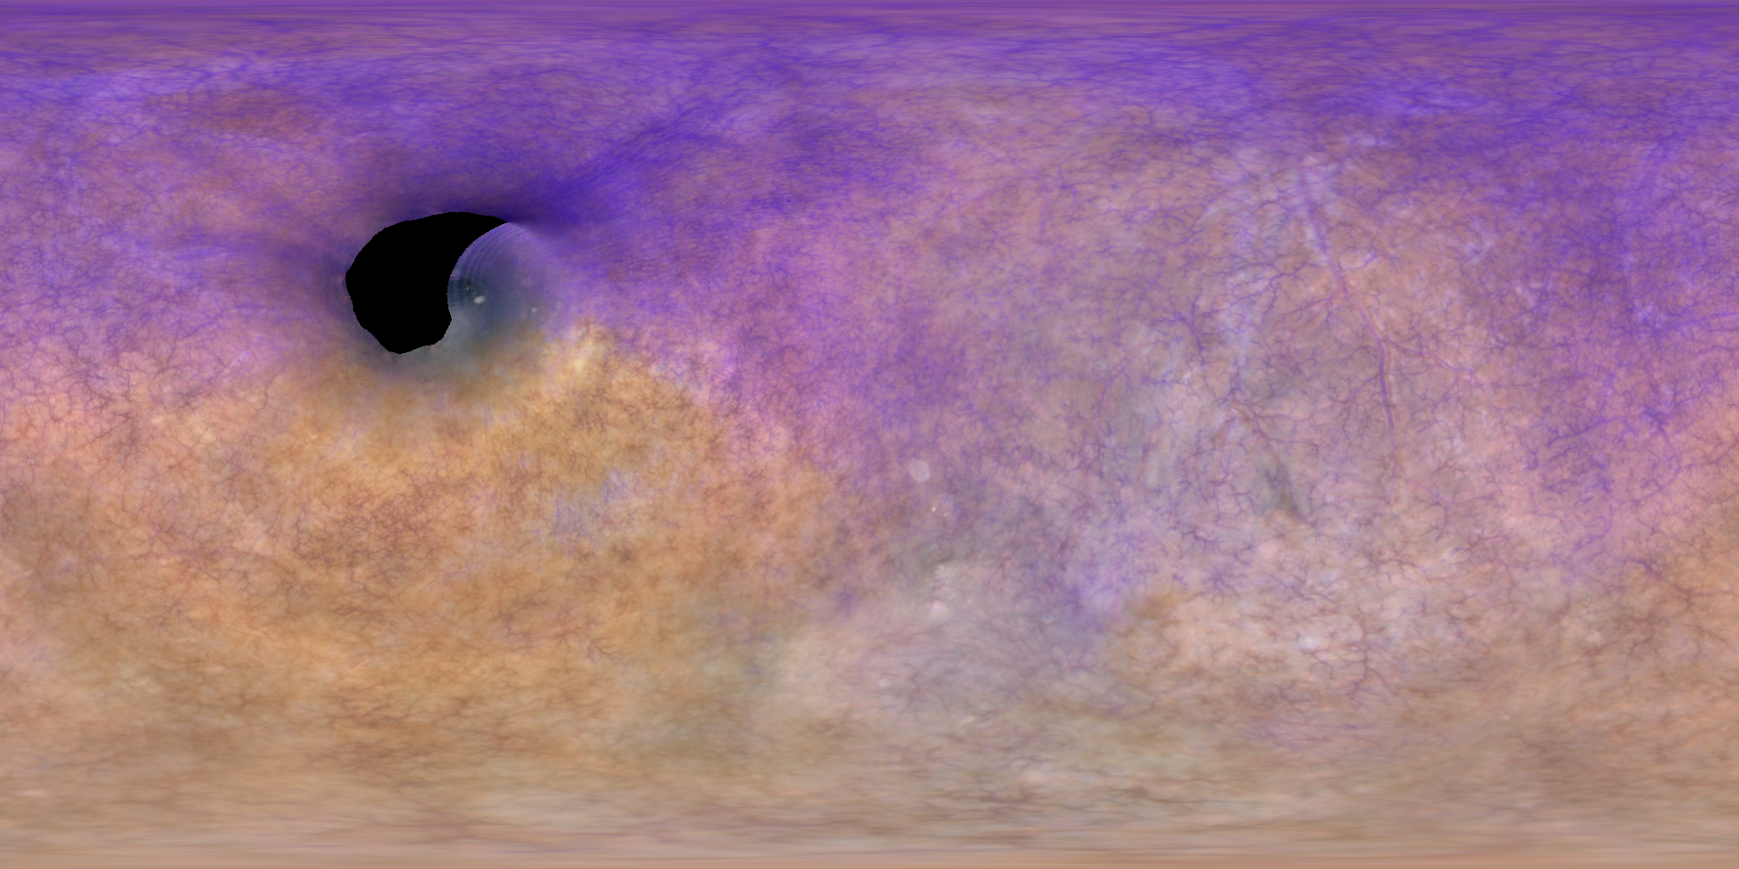
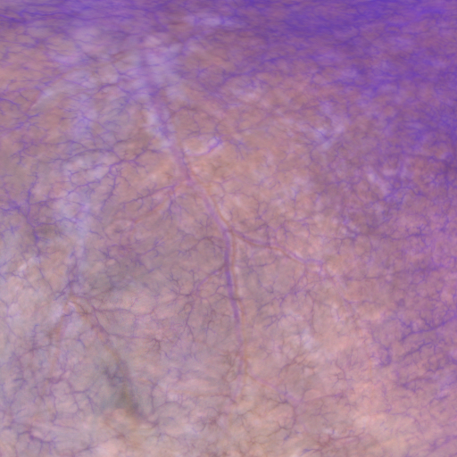
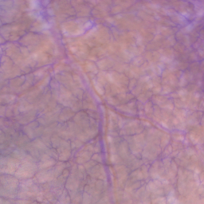
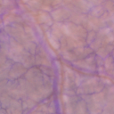

Experiment 2: Reconstruction 2D

Slide 15
Conclusions
Several hundred frames aligned with pixel level accuracy.
No calibration necessary
Spherical model proved adequate
Sufficient overlap is essential!

Slide 16
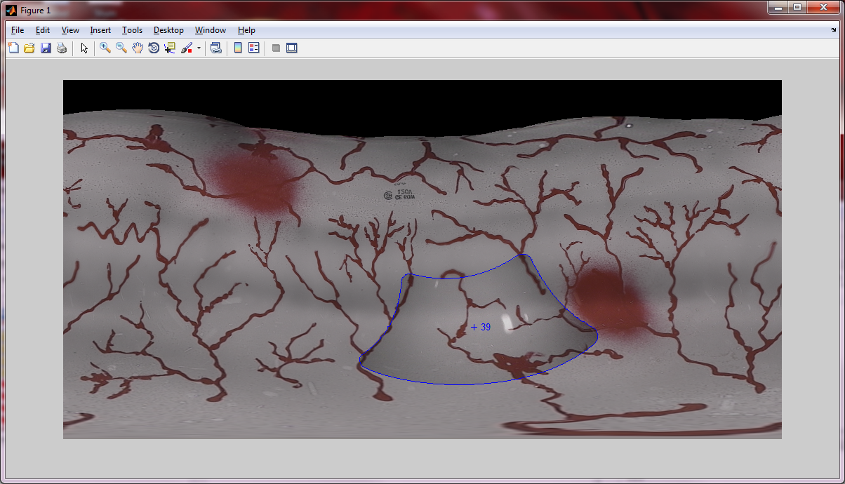
Future Work
Validate automated scanning mechanism
Improve blending, deghosting
Develop interface

Slide 17
Acknowledgements
Human Photonics Laboratory
Rich Johnston
Charles Melville
Cameron Lee
Coulter Foundation & University of Washington Department of Bioengineering
University of Washington Center for Commercialization
email: tsoper@uw.edu
Funding

Slide 19
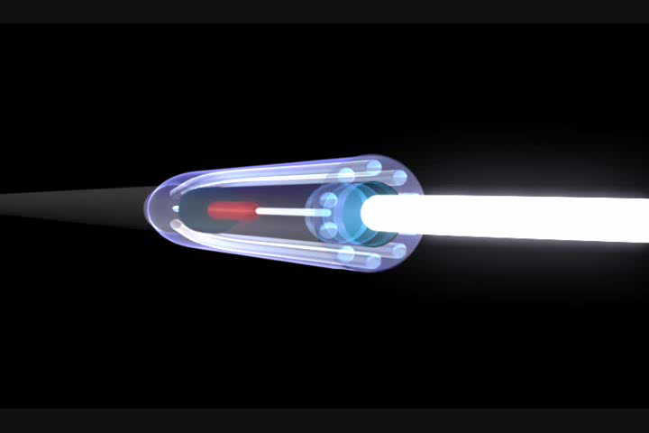
Scanning Fiber Endoscope (SFE)
Animation by Mr. Duff Hendrickson, Seattle, WA, copyright University of Washington.

Slide 20






Full Panoramic Reconstruction
Reconstruction Metrics:
Single mosaic of entire bladder
No presumed shape
Global alignment
No Calibration
Structure from Motion:
Simultaneously recover scene geometry and camera motional
$$M=number of points$$
N$=number of cameras$
$$number of parameters=3M+6N+6$$
$$(X,Y,Z)$$
$$(θ,φ,ρ,t_{x},t_{y}, t_{z})$$
Virtual Tourism¹
$$(f_{x},f_{y},u_{0},v_{0},κ_{1},κ_{2})$$
¹Snavely, N., Seitz, S. M., and Szeliski, R., ACM Transactions on Graphics, 2006.

Slide 21


Bundle Adjustment
Feature detection
Frame matching
Track assignment
Bundle adjustment
Stitching
VIDEO
Non-linear least squares minimization between the observed and predicted pixel positions:
$$f=u−\tilde{u}, c=f^{T}f$$
Camera Equations:
$$\tilde{x}, \tilde{y}$$
$${[X_{c} Y_{c} Z_{c}]}^{T}=R_{c}{[X Y Z]}^{T}+t_{c}$$
(3D rigid body)
$$\hat{x},\hat{y}$$
$(X_{c},Y_{c},Z_{c}$)
$$u_{0},v_{0}$$
$\hat{x}=\frac{X_{c}}{Z_{c}}, \hat{y}=\frac{Y_{c}}{Z_{c}}$
(projective)
$$O_{c}$$
$$\tilde{x}=x\left(1+κ_{1}r^{2}+κ_{2}r^{4}\right)$$
(radial distortion)
$$\tilde{y}=y\left(1+κ_{1}r^{2}+κ_{2}r^{4}\right)$$
$$\tilde{u}=f_{x}\tilde{x}+u_{0}, \tilde{v}=f_{y}\tilde{y}+v_{0}$$
(camera
equations)
State variable: $x=[X_{1}^{T},…,X_{M}^{T}, θ_{1}^{T},t_{1}^{T},…,θ_{N}^{T}, t_{N}^{T}, f_{x}, f_{y}, u_{0}, v_{0}, κ_{1},κ_{2}]$
$$Δx={−\left(H+λ⋅diag\left(H\right)\right)}^{−1}∇c(x)$$
Levenberg-Marquardt
Large parameter sets solved by exploiting sparsity!
3D point parameters and camera parameters do not combine
Each camera sees only a subset of points

Slide 22

Constructing Planar Panoramas of the Bladder
Planar Homography:
$${\left[\begin{matrix}ωx′ & ωy′ & ω\end{matrix}\right]}^{T}=H{\left[\begin{matrix}x & y & z\end{matrix}\right]}^{T}$$
H
Limitations:
Assumes planar scene
  misalignment
  pixel stretching
Limited FOV
Lacks global alignment
Requires precalibration

Slide 23
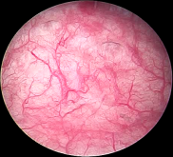
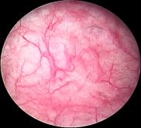
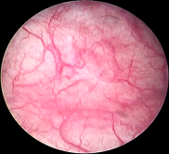
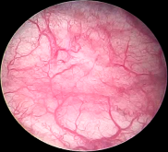
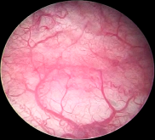
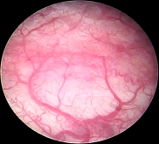









Frame Matching
Feature detection
Frame matching
Track assignment
Bundle adjustment
Stitching
VIDEO
$$k−2$$
$$k−1$$
$$k$$
$$k+1$$
$$k+2$$
$$k$$
$$k+3$$
$k$+3
$$k$$
$k$+3
Sequential frame matching

Slide 24
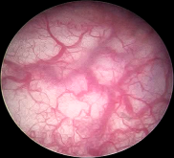
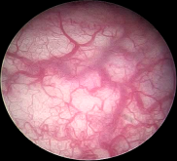
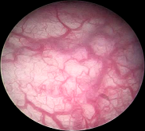
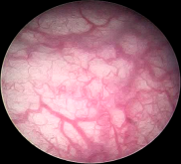
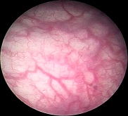
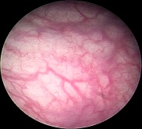







Frame Matching
Feature detection
Frame matching
Track assignment
Bundle adjustment
Stitching
VIDEO
$$k−m−2$$
$$k−m−1$$
$$k−2$$
$$k−m$$
$$k−m$$
$$k−1$$
$$k−m+1$$
$$k$$
$$k−m+2$$
$$k+1$$
$$k−m+3$$
$$k+2$$
$$k$$
$$k+3$$
$k$+3
$$k$$
$k$+3
Nonsequential frame matching

Slide 25
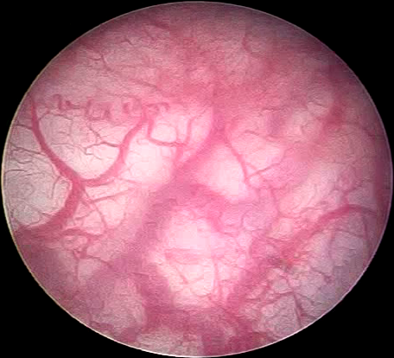
Frame Matching
Frame selection
Frame matching
Track assignment
Bundle adjustment
Stitching
VIDEO
Feature Matching (step1):
Feature Matching (step2):
Match each point to it’s nearest neighbor in feature space
RANdom SAmple Consensus (RANSAC):
Compute homography (H )
with the most inliers

Slide 26

Feature Detection
Frame selection
Frame matching
Track assignment
Bundle adjustment
Stitching
VIDEO
Scale Invariant Feature Transform (SIFT¹)
Scale, rotation invariant
Keypoints $[x_{1},x_{2}, …, x_{n}]$
Descriptors $[D_{1},D_{2}, …, D_{n}]$
¹Lowe, International Journal of Computer Vision, 2004

Slide 27






Frame Matching
Feature detection
Frame matching
Track assignment
Bundle adjustment
Stitching
VIDEO
$$i−1$$
$$i$$
$$j$$
$$i+1$$
$$i$$
$$j$$
$$k$$
$$k$$
$k$+3
$$k$$
$k$+3
Associated frame matching

